Slide 1
F5 301a v14.1 Certification Prep
Paul Deakin, Wade Huff, Daniel Cayer, David Larsen
F5 Systems Engineers
March 2024

Slide 2
K70671013: BIG-IP LTM-DNS operations guide
The current study guide for the 301a is based on v11.4 and has not been updated, though most the information remains the same. But I strongly recommend you review the above article, you will also see many links from the following manuals:
Manual : BIG-IP Local Traffic Management: Basics
https://techdocs.f5.com/en-us/bigip-14-1-0/big-ip-local-traffic-management-basics-14-1-0.html
Manual : BIG-IP TMOS: Routing Administration
https://techdocs.f5.com/en-us/bigip-14-1-0/big-ip-tmos-routing-administration-14-1-0.html

Slide 3
Architect and Deploy Applications

Slide 4
1.01
Determine which configuration objects are necessary to optimally deploy an application
Determine least amount of configuration objects needed to deploy application
Understand dependencies of configuration objects
Understand needed LTM profiles to deploy an application
Identify unnecessary configurations objects
Understand the differences between virtual servers and virtual addresses

Slide 5
Topic Resources
https://techdocs.f5.com/kb/en-us/products/big-ip_ltm/manuals/product/tmos-routing-administration-13-1-0.html
Manual Chapter : Interfaces
https://clouddocs.f5.com/cli/tmsh-reference/v13/ with link to Full TMSH Reference Guide PDF
Manual Chapter: Trunks
Manual Chapter : VLANs VLAN Groups and VXLAN
Manual Chapter : Self IP Addresses

Slide 6
1.02
Determine whether or not an application can be deployed with only the LTM module provisioned
Identify the functionality of LTM configuration objects
Identify LTM profile settings to deploy an application
Determine capabilities of LTM configuration objects

Slide 7
Topic Resources
https://techdocs.f5.com/kb/en-us/products/big-ip_ltm/manuals/product/tmos-routing-administration-13-1-0.html
Manual Chapter : Interfaces
https://clouddocs.f5.com/cli/tmsh-reference/v13/ with link to Full TMSH Reference Guide PDF
Manual Chapter: Trunks
Manual Chapter : VLANs VLAN Groups and VXLAN
Manual Chapter : Self IP Addresses

Slide 8
1.03
Identify the difference between deployments (e.g., one arm, two arm, npath, Direct Server Return (DSR)
Identify configuration objects needed for L2/L3 nPath routing
Determine how the IP address changes when using DSR
Determine how IP addresses change when using a full proxy deployment
Plan the network considerations for one arm & two arm deployments
Understand the importance of auto last-hop

Slide 9
Topic Resources
Manual Chapter : NATS and SNATs
K7336: The SNAT Automap and self IP address selection
K7820: Overview of SNAT features
K8246: How the BIG-IP system handles SNAT port exhaustion
K9038: The order of precedence for local traffic object listeners
K14800: Order of precedence for virtual server matching (11.3.0 and later)
Manual Chapter : Setting Connection Limits
K8457: Connection limits for a CMP system are enforced per TMM instance
Manual: Session Persistence Profiles

Slide 10
1.04
Choose correct profiles and settings to fit application requirements
Identify LTM profile settings to deploy OneConnect
Determine which profiles are needed to deploy an application
Compare and contrast different communication protocols (TCP, UDP, FastL4)
Compare performance impact of LTM profile settings

Slide 11
Topic Resources
Manual Chapter : NATS and SNATs
K7336: The SNAT Automap and self IP address selection
K7820: Overview of SNAT features
K8246: How the BIG-IP system handles SNAT port exhaustion
K9038: The order of precedence for local traffic object listeners
K14800: Order of precedence for virtual server matching (11.3.0 and later)
Manual Chapter : Setting Connection Limits
K8457: Connection limits for a CMP system are enforced per TMM instance
Manual: Session Persistence Profiles

Slide 12
1.05
Choose virtual server type and load balancing type to fit application requirements
Determine the difference between L2-L3 virtual servers
Compare and contrast standard and fastL4 virtual server types
Compare and contrast different load balancing methods
Identify different load balancing method use cases

Slide 13
Topic Resources
Manual Chapter : NATS and SNATs
K7336: The SNAT Automap and self IP address selection
K7820: Overview of SNAT features
K8246: How the BIG-IP system handles SNAT port exhaustion
K9038: The order of precedence for local traffic object listeners
K14800: Order of precedence for virtual server matching (11.3.0 and later)
Manual Chapter : Setting Connection Limits
K8457: Connection limits for a CMP system are enforced per TMM instance
Manual: Session Persistence Profiles

Slide 14
1.06
Determine how to architect and deploy multi-tier applications using LTM technology
Understand connection based architecture and when/how to apply SNAT/persistence/SSL settings in a multi-tiered environment
Identify which device handles specific configuration objects in a multi-tiered deployment

Slide 15
Topic Resources
Manual Chapter : NATS and SNATs
K7336: The SNAT Automap and self IP address selection
K7820: Overview of SNAT features
K8246: How the BIG-IP system handles SNAT port exhaustion
K9038: The order of precedence for local traffic object listeners
K14800: Order of precedence for virtual server matching (11.3.0 and later)
Manual Chapter : Setting Connection Limits
K8457: Connection limits for a CMP system are enforced per TMM instance
Manual: Session Persistence Profiles

Slide 16
1.07
Distinguish between packet based versus connection-based load balancing
Demonstrate when to use packet based load balancing
Demonstrate when to use connection based load balancing

Slide 17
Topic Resources
Manual Chapter : NATS and SNATs
K7336: The SNAT Automap and self IP address selection
K7820: Overview of SNAT features
K8246: How the BIG-IP system handles SNAT port exhaustion
K9038: The order of precedence for local traffic object listeners
K14800: Order of precedence for virtual server matching (11.3.0 and later)
Manual Chapter : Setting Connection Limits
K8457: Connection limits for a CMP system are enforced per TMM instance
Manual: Session Persistence Profiles

Slide 18
1.08
Determine which configuration objects are necessary for applications that need the original client IP address
Determine when SNAT is required
Determine the required SNAT type
Identify functions of X-forwarded-for
Outline the steps needed to return the traffic to LTM without SNAT

Slide 19
Topic Resources
Manual Chapter : NATS and SNATs
K7336: The SNAT Automap and self IP address selection
K7820: Overview of SNAT features
K8246: How the BIG-IP system handles SNAT port exhaustion
K9038: The order of precedence for local traffic object listeners
K14800: Order of precedence for virtual server matching (11.3.0 and later)
Manual Chapter : Setting Connection Limits
K8457: Connection limits for a CMP system are enforced per TMM instance
Manual: Session Persistence Profiles

Slide 20
1.09
Identify the matching order of multiple virtual servers
Identify which virtual server would process particular traffic
Identify why the virtual server fails to receive traffic

Slide 21
Topic Resources
Manual Chapter : NATS and SNATs
K7336: The SNAT Automap and self IP address selection
K7820: Overview of SNAT features
K8246: How the BIG-IP system handles SNAT port exhaustion
K9038: The order of precedence for local traffic object listeners
K14800: Order of precedence for virtual server matching (11.3.0 and later)
Manual Chapter : Setting Connection Limits
K8457: Connection limits for a CMP system are enforced per TMM instance
Manual: Session Persistence Profiles

Slide 22
1.10
Given a basic iRule's functionality, determine the profiles and configuration options necessary to implement the iRule
Determine what virtual server profile is necessary
Determine when persistence profile is necessary

Slide 23
Topic Resources
Manual Chapter : NATS and SNATs
K7336: The SNAT Automap and self IP address selection
K7820: Overview of SNAT features
K8246: How the BIG-IP system handles SNAT port exhaustion
K9038: The order of precedence for local traffic object listeners
K14800: Order of precedence for virtual server matching (11.3.0 and later)
Manual Chapter : Setting Connection Limits
K8457: Connection limits for a CMP system are enforced per TMM instance
Manual: Session Persistence Profiles

Slide 24
1.11
Describe how to deploy applications using iApp templates
Identify when an iApp is appropriate
Recognize how to modify an application deployed with an iApp
Identify objects created by an iApp

Slide 25
Topic Resources
Manual Chapter : NATS and SNATs
K7336: The SNAT Automap and self IP address selection
K7820: Overview of SNAT features
K8246: How the BIG-IP system handles SNAT port exhaustion
K9038: The order of precedence for local traffic object listeners
K14800: Order of precedence for virtual server matching (11.3.0 and later)
Manual Chapter : Setting Connection Limits
K8457: Connection limits for a CMP system are enforced per TMM instance
Manual: Session Persistence Profiles

Slide 26
Set Up, Administer, and Secure LTM Devices

Slide 27
2.01
Determine how to secure Self IPs
Identify which administrative services need to be accessible
Identify which configurations objects are allowing accessibility
Identify which services must be enabled for HA availability between devices

Slide 28
Topic Resources
Manual Chapter: Virtual Servers
Manual Chapter : Session Persistence Profiles

Slide 29
2.02
Determine how to secure virtual servers
Determine how to limit access to virtual servers
Compare and contrast different virtual server types
Identify LTM profiles setting to limit access to virtual server resources

Slide 30
Topic Resources
Manual Chapter: Virtual Servers
Manual Chapter : Session Persistence Profiles

Slide 31
2.03
Determine how to perform basic device configuration
Identify how to synch time/date amongst LTM devices
Determine how to limit administrative access to LTM device (GUI/CLI)
Identify how to restrict access to administrative partitions

Slide 32
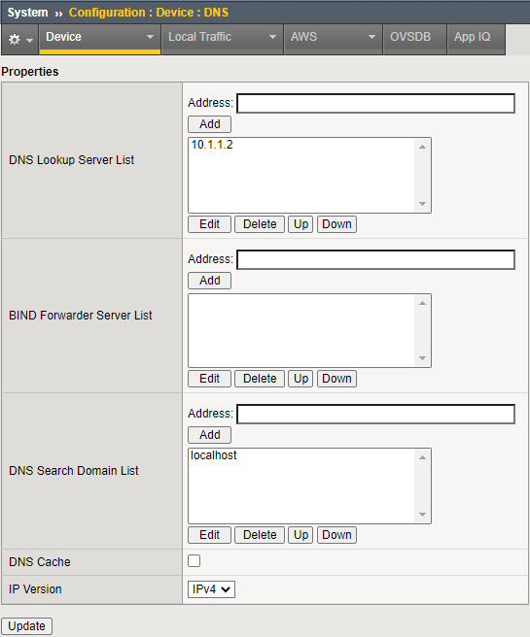
3.09 Show proper configuration for: DNS, NTP, SNMP, syslog
Manual Chapter : General Configuration Properties
DNS Lookup Server List enables users to use the following for accessing virtual servers, nodes, or other network objects.
IP addresses
host names
fully-qualified domain names (FQDNs)
The DNS Search Domain List enables BIG-IP to search for local domain lookups to resolve local host names.
Additionally, you can manually configure the BIND Forwarder Server List that provides DNS resolution for servers and other equipment load-balanced by the BIG-IP system (for the servers that the BIG-IP system uses for DNS proxy services).

Slide 33
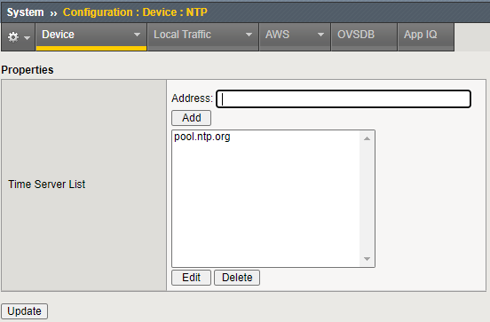
3.09 Show proper configuration for: DNS, NTP, SNMP, syslog
Manual Chapter : General Configuration Properties
K13380: Configuring the BIG-IP system to use an NTP server from the command line (11.x - 13.x)
NTP is essential for:
Device Service Clusters
Configsync
Logging

Slide 34
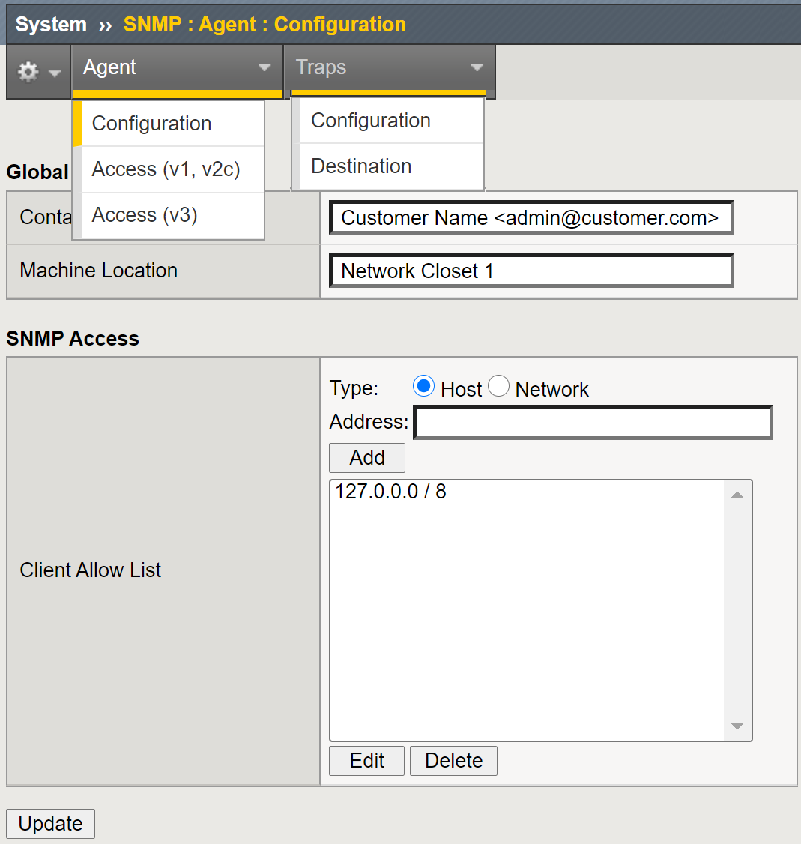
3.09 Show proper configuration for: DNS, NTP, SNMP, syslog
Manual Chapter : Monitoring BIG-IP System Traffic with SNMP
BIG-IP SNMP agent configuration
The primary tasks in configuring the SNMP agent are configuring client access to the SNMP agent, and controlling access to SNMP data.
Task Summary
Specify SNMP administrator contact information and system location information
Configure SNMP manager access to the SNMP agent on the BIG-IP system
Grant community access to v1 or v2c SNMP data
Grant user access to v3 SNMP data
Notes:
You can use the industry-standard SNMP protocol to manage BIG-IP® devices on a network. To do this, you must configure the SNMP agent on the BIG-IP system. The primary tasks in configuring the SNMP agent are configuring client access to the SNMP agent, and controlling access to SNMP data.

Slide 35
3.09 Show proper configuration for: DNS, NTP, SNMP, syslog
Manual Chapter : Monitoring BIG-IP System Traffic with SNMP
SNMP trap configuration
Configuring SNMP traps on a BIG-IP system means configuring how the BIG-IP system handles traps, as well as setting the destination to which the notifications are sent.
The BIG-IP system stores SNMP traps in two specific files:
/etc/alertd/alert.conf - contains default SNMP traps.
Important: Do not add or remove traps from the /etc/alertd/alert.conf file.
/config/user_alert.conf - contains user-defined SNMP traps.
Task Summary
Enabling traps for specific events
Setting v1 and v2c trap destinations
Setting v3 trap destinations
Notes:
SNMP traps are definitions of unsolicited notification messages that the BIG-IP® alert system and the SNMP agent send to the SNMP manager when certain events occur on the BIG-IP system. Configuring SNMP traps on a BIG-IP system means configuring how the BIG-IP system handles traps, as well as setting the destination to which the notifications are sent.

Slide 36
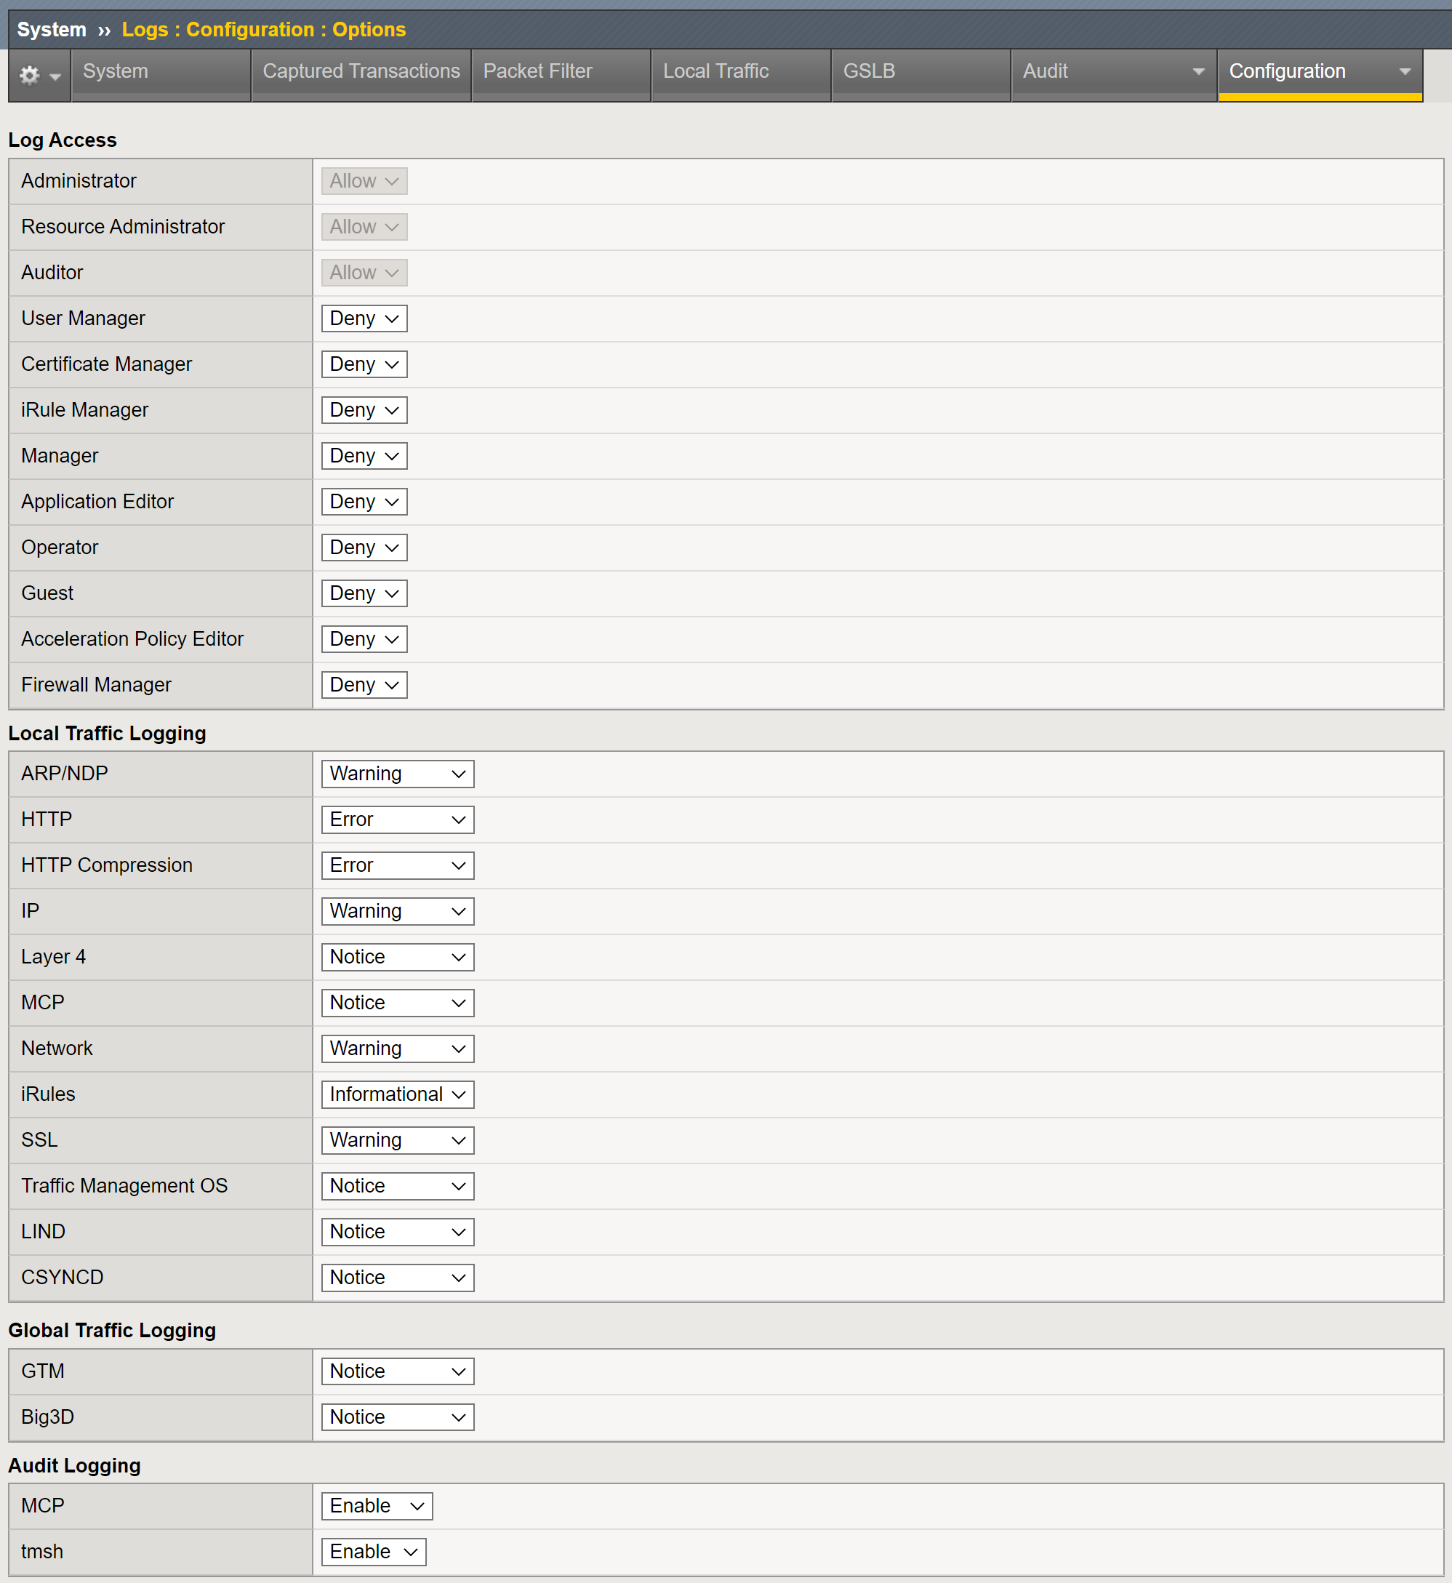
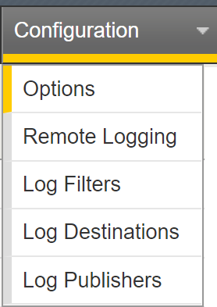
3.09 Show proper configuration for: DNS, NTP, SNMP, syslog
Manual Chapter : About Logging
Log Destinations
The High-Speed Logging (HSL) or Unformatted destination
Defines the protocol to use (UDP or TCP)
Defines the server pool the log message will go too
The Formatted destination defines the format of the messages being sent
There are two parts to a Destination
Where a message is going : HSL Destination
What the message looks like: Formatted Destination
Publisher
A Publisher is a collection of Formatted Destinations
Notes:
Remote Logging for all BIG-IP modules consists of three common logging elements; Pools, Destinations and Publishers.
Pools are a collection of logging servers defined by IP address and port.
Destinations define the format the messages and the pool the message is to be sent too. You will always have to configure to high-speed destinations, a unformatted destination and a formatted destination.
Unformatted aka High-Speed Logging (HSL) destinations defined the pool a message will be sent too.
Formatted destinations define the format of the message (i.e. Splunk or Syslog) and the HSL destination of the formatted message.
Publishers are collections for Formatted Destination. Messages generated will be sent to each Formatted Destination in a publisher.

Slide 37
Remote Logging Steps
Create a Pool of logging server(s)
Create an HSL Destination (define the protocol TCP/UDP and Poo)
Create a Formatted Destination (define format ie. syslog, arcsight)
Create a Publisher
Logging Application Steps (varies by Application)
System Logging
linux host daemons, etc
Uses filters
Security Logging
Advanced Firewall Manager, DNS Firewall, Protocol Security Module and the Applications Security Manager
Uses Security Logging Profile
High Speed DNS Query Logging:
Uses Security Logging Profile
Notes:
Here are the steps involved in remote logging under the new logging paradigm. While it appears to be a lot of steps, the flexibility and power are well worth the additional effort.
The user creates a pool of remote logging servers, a High Speed Logging Destination, a Formatted Destination, and a Publisher. Further configuration steps depend on which logging application is being configured. System Logging uses Filters. The Advanced Firewall Manager (AFM), Protocol Security Module (PSM) and Application Security Manager (ASM) modules, along with High Speed DNS Logging, all use logging profiles which are then attached to the relevant configuration elements.

Slide 38
Logging Overview
System
Security
Publisher
Formatted Destination
HSL
Dest.
Pool
High Speed DNS
Different
Formatted Destination
HSL
Dest.
Pool
Notes:
Here's another way to look at it. Log Messages from the System, Advanced Firewall Manager (AFM), or High Speed DNS logging all go through a Publisher, which is a list of Destinations. Generally, those Destinations will be Formatted Destinations. The formats supported in this release are Syslog, Splunk, and ArcSight. Formatted Destinations forward to a High Speed Logging (HSL) Destination, which consists of a pool name. The HSL Destination then forwards to the Pool of log servers.
The publisher could actually send the messages to multiple locations in multiple formats, if needed.

Slide 39
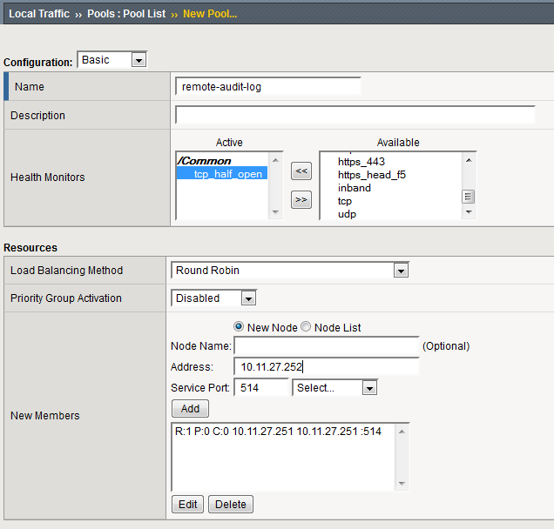
Pool Creation - GUI
Notes:
Creation of a pool of logging servers is no different than creating any other pool. This screen should be familiar to you.

Slide 40
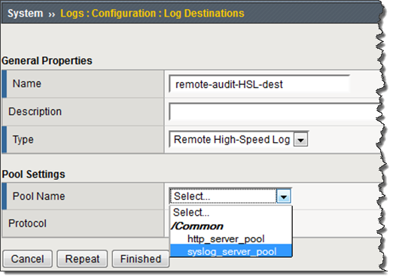
High-Speed Log Destination Creation
Unformatted
This defines HSL destination the messages go to, not what they look like
Must be create before formatted destinations
Notes:
We'll start with the Remote High Speed Log, or HSL, Destination Type, as it is the foundation for the other three Types. You cannot use the three formatted Destination Types without an HSL Destination. As shown here, we define the HSL Destination by selecting the pool of log servers defined previously. The other element is the Protocol, not shown here. TCP and UDP are the options. TCP is the default.
The HSL destination by itself has limited application for most users, but is a required component for the 3 supported destinations that provide formatting. We'll look at those 3 formatted destinations shortly.

Slide 41
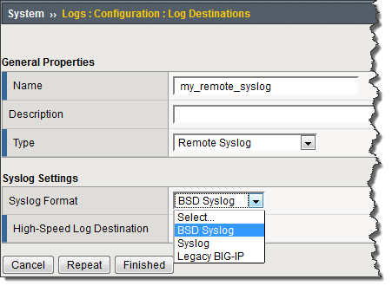
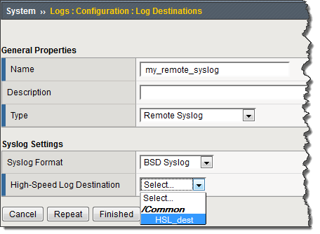
Remote Syslog Destination Creation
Name your log destination
Select a syslog format
Select a High-Speed Log Destination
Unformatted Destination you created earlier
Notes:
Here is a screenshot showing the creation of a remote syslog Destination. The steps involved are naming the Destination,<click> specifying which syslog format your pool members use <click> and selecting the previously created High Speed Log Destination.

Slide 42
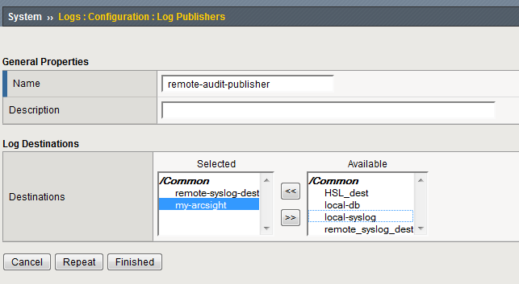
Log Publisher
A Publisher is a collection of Destinations
Configuration Elements:
Choose a unique name for this Publisher
(Optionally) Enter a Description
Select Destination(s) from the available choices
Notes:
A Log Publisher is a collection or list of log Destinations you want to send the message too. Here the user has selected two Destinations.
Log Publishers are used by Filters for System Logging and by Logging Profiles for the Advanced Firewall Manager, Protocol Security Module, and High Speed DNS Logging. These applications are discussed later.

Slide 43
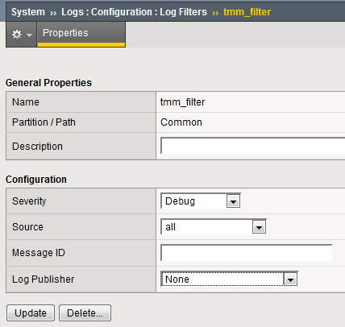
tmm_filter (aka System Logging filter)
Under System > Logs > Configuration > Log Filters
Can create custom filters
Name
Description (optional)
Severity
Default is Debug
Source
List of processes
Defaults to all
Message ID
Log Publisher
Notes:
The new way to configure System Logging requires the elements described previously and a new feature call the System Logging (TMM) Filter.
The System Logging Filter configuration elements consist of a unique Name,<click> an optional description<click>, a Severity threshold<click>, a Source of log messages<click>, which can be a single process or all processes, an optional message ID to match against<click>, and a Log Publisher<click>. We'll look into some of these elements in more detail.

Slide 44
Tools for Testing – DNS, NTP, SNMP, SYSLOG
DNS
You should know to use and interpret the results of the dig utility
NTP
K10240: Verifying NTP peer server communications
SNMP
There is a test snmp button on the configuration page
Good old tcpdump
Show services
tmsh show service <service> or tmsh show service (shows all services)
From the linux prompt: bigstart status

Slide 45
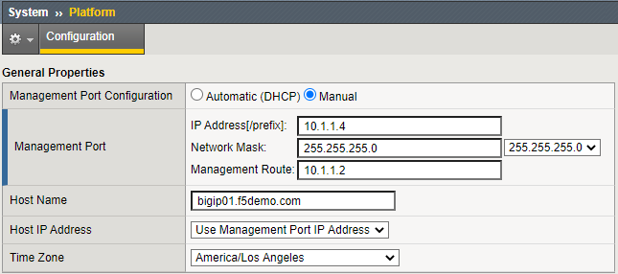
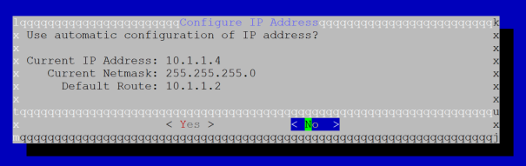
3.03 Identify the configured management-IP address
GUI
TMSH
tmos)# list sys management-ip
sys management-ip 10.1.1.4/24 {
description configured-statically
}
“config” utility at the linux prompt

Slide 46
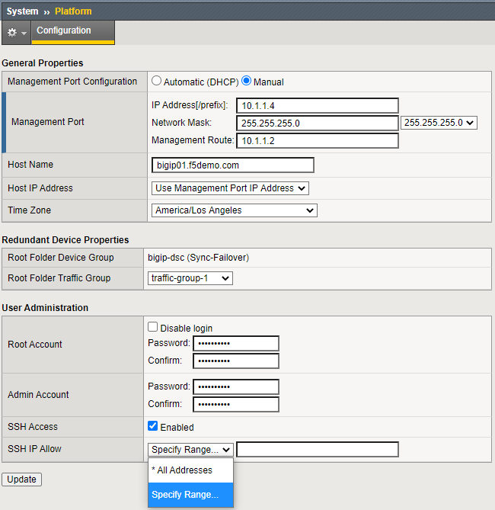
3.03 Identify SSH access list to management-IP address
K13309: Restricting access to the Configuration utility by source IP address (11.x - 16.x)
To add to the allow list:
modify /sys sshd allow add { <IP address or IP address range> }
To replace the list
modify /sys sshd replace-all-with {<IP address or IP address range>}
Default is:
Save the change by entering the following command:
save /sys config
(tmos)# list sys sshd allow
sys sshd {
allow { All }
}

Slide 47
3.03 Identify HTTP access list to management-IP address
K13309: Restricting access to the Configuration utility by source IP address (11.x - 16.x)
To add to the allow list:
modify /sys httpd allow add { <IP address or IP address range> }
To replace the list
modify /sys httpd replace-all-with {<IP address or IP address range>}
Default is:
Save the change by entering the following command:
save /sys config
(tmos)# list sys httpd allow
sys httpd {
allow { All }
}

Slide 48
3.03 Show remote connectivity to the BIG-IP Management interface
You connect to the Management interface
GUI over HTTPS (port 443)
Terminal via SSH (port 22)
By default these ports are open on the OOB Manage IP
You can also connect to the management interfaces via a self IP address
You must modify the default port lockdown of “None”
You should never open management interfaces to the internet

Slide 49
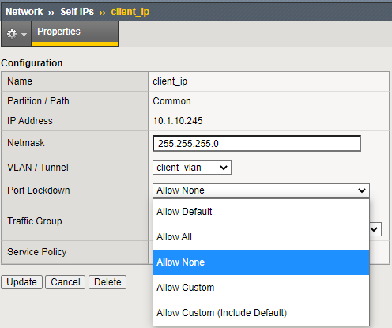
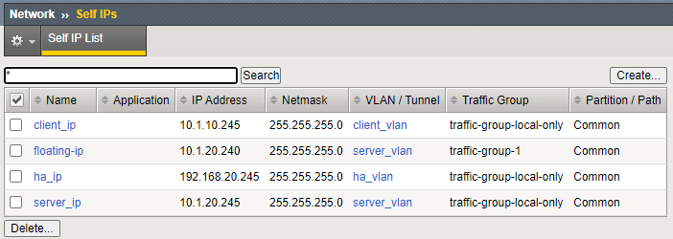
3.03 Interpret port lockdown settings to Self-IP
Port Lockdown determines which ports a self IP address will respond too
By default Port Lockdown is none, the self IP only responds to ICMP
Port Lockdown settings can be modified to allow other traffic, such as, port 443 or 22 for management

Slide 50
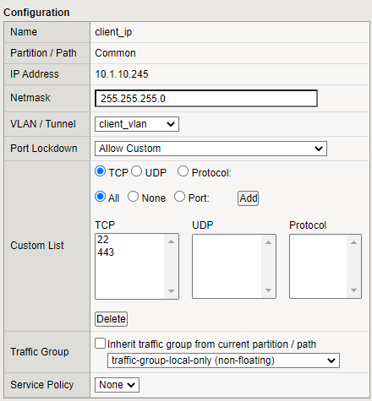
3.03 Interpret port lockdown settings to Self-IP
You can select “Allow Default” which opens the following:
ospf:any
tcp:domain (53)
tcp:f5-iquery (4353)
tcp:https (443)
tcp:snmp (161)
tcp:ssh (22)
udp:520
udp:cap (1026 - for network failover)
udp:domain (53)
udp:f5-iquery (4353)
udp:snmp (161)
Or you can select custom ports to open
list net self
net self client_ip {
address 10.1.10.245/24
allow-service {
tcp:ssh
tcp:https
}

Slide 51
3.03 Identify SSH access list to management-IP address
K13309: Restricting access to the Configuration utility by source IP address (11.x - 16.x)
To add to the allow list:
modify /sys sshd allow add { <IP address or IP address range> }
Range uses space ie. {10.1.1.1 10.1.1.10}
To replace the list
modify /sys sshd replace-all-with {<IP address or IP address range>}
Default is:
Save the change by entering the following command:
save /sys config
(tmos)# list sys sshd allow
sys sshd {
allow { All }
}
Notes:
You can restrict access to the management port, both SSH and GUI via access list.

Slide 52
3.03 Identify HTTP access list to management-IP address
K13309: Restricting access to the Configuration utility by source IP address (11.x - 16.x)
To add to the allow list:
modify /sys httpd allow add { <IP address or IP address range> }
To replace the list
modify /sys httpd replace-all-with {<IP address or IP address range>}
Default is:
Save the change by entering the following command:
save /sys config
(tmos)# list sys httpd allow
sys httpd {
allow { All }
}

Slide 53
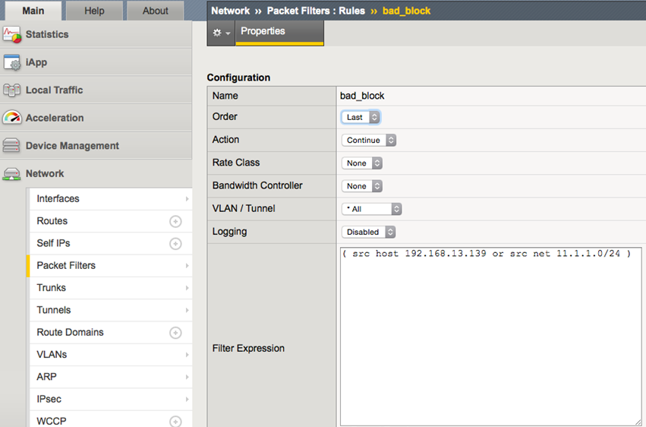
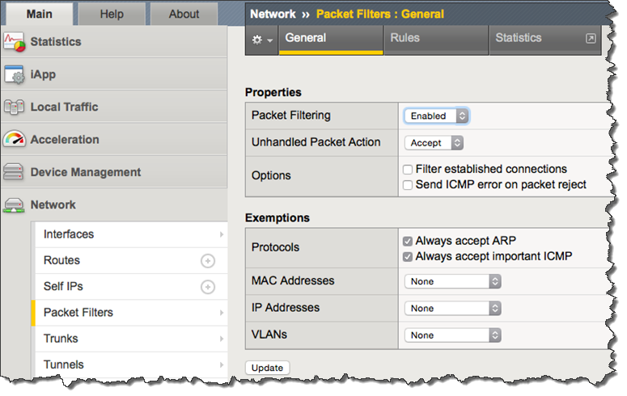
Restricting Access to Management Ports on Self IPs
(src host 192.168.13.139 or src net 11.1.1.0/24)

Slide 54
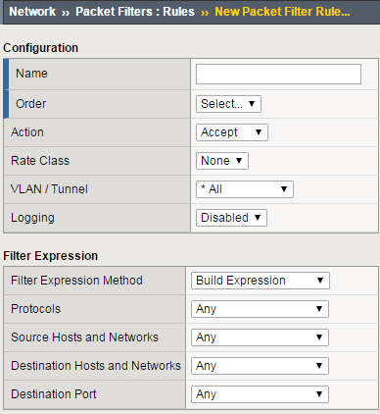
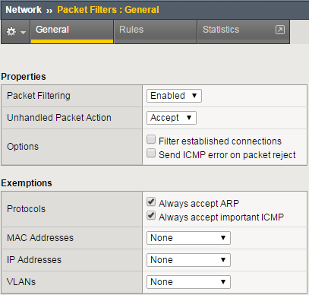
Packet Filtering
Disabled be default, but once you enable
Notes:
<intentionally left blank>

Slide 55
3.03 Explain management IP connectivity issue
If using OOB Management
Is the IP, netmask and default gateway configured correctly
Is the interface up
At the Linux prompt: ifconfig -a mgmt
If using a Self IP
Is the IP and netmask configured correctly
Are they routable
Are the appropriate ports open, 22 for SSH and/or 443 for the GUI interface
Are the any packet filters blocking traffic

Slide 56
Topic Resources
Manual Chapter: Virtual Servers
Manual Chapter : Session Persistence Profiles

Slide 57
2.04
Determine how to perform a software upgrade while maintaining application availability
Identify proper steps to avoid downtime while upgrading LTM software
Determine necessary steps for migrating LTM configuration to new hardware
Understand implications of stopping BIG-IP services

Slide 58
YouTube: Updating BIG-IP HA systems with a point release
This video walks you through the steps to upgrade a BIG-IP HA pair:
0:13 Part 1: Installing the point release on the first device
0:40 Validating the configuration
1:53 Verifying the Service check date
3:23 Synchronizing the configuration
4:32 Creating and saving a UCS archive
5:52 Importing the ISO file
7:05 Verifying the MD5 checksum
7:45 Disabling the "Automatic with Incremental Sync" option
8:30 Installing and rebooting to the new version
14:16 Verifying the new point release version is active on the newly patched system
15:00 Forcing a failover
16:20 Part 2: Installing the point release on the next device
16:25 Repeat these steps
16:49 Verifying the new point release version is active on the newly patched system
17:46 Forcing a failover
19:25 Part 3: Performing the final ConfigSync
Notes:
Watch the YouTube video.

Slide 59
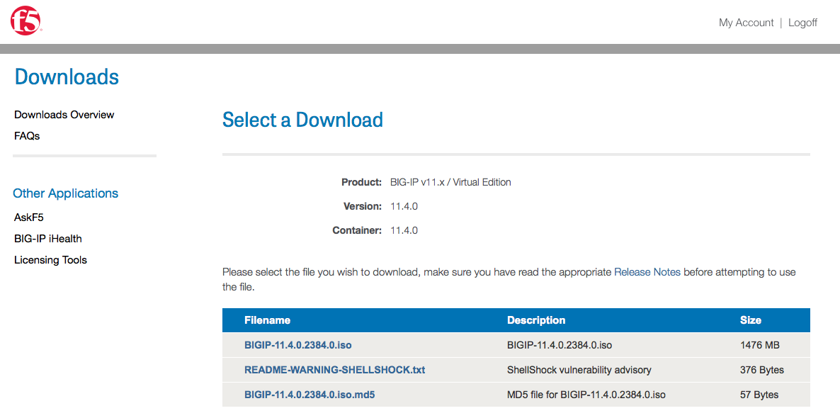
https://downloads.f5.com
Requires an f5 account
Notes:
You can find your software images on https://downloads.f5.com. It will require you to have an F5 account.

Slide 60
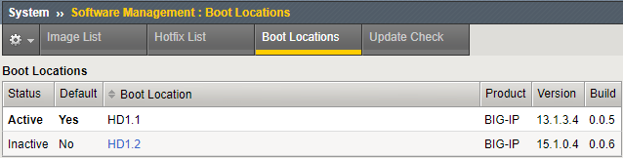
3.06 Show currently configured boot location
(tmos)# show sys software
--------------------------------------------------
Sys::Software Status
Volume Product Version Build Active Status
--------------------------------------------------
HD1.1 BIG-IP 13.1.3.4 0.0.5 yes complete
----------------------------
Sys::Software Update Check
----------------------------
Check Enabled true
Phonehome Enabled true
Frequency weekly
Status failure
Errors 8
Notes:
Finding the boot location is relatively simple again you can do it through TMSH or through the GUI when you go to system software management boot locations the active status is the boot volume.

Slide 61
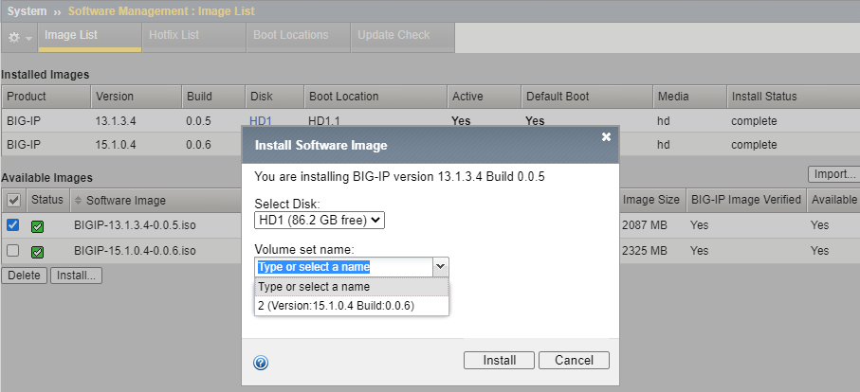
3.06 Demonstrate creating new volume for software images
install sys software image <iso> volume <name>
Notes:
Creating software images can be done through TMSH or the GUI. When installing a new software image you have the option of installing on a current inactive boot volume or creating a new boot volume by using alphanumerics to create a new boot volume. Except for BIG-IP VE 1 slot versions, BIG-IPs will be able to have two or more boot volumes. If disk space is not available for a new volume, then you will have to overwrite or delete and existing inactive volume.

Slide 62
3.05 Summarize the use case of a UCS backup
K4423: Overview of UCS archives
A user configuration set (UCS) is a backup file that contains BIG-IP configuration data that can be used to fully restore a BIG-IP system in the event of a failure or Return Materials Authorization (RMA) replacement.
A UCS archive is a compressed file that contains all of the configuration files that are typically required to restore your current configuration to a new system
Contents of the UCS archive file
All BIG-IP-specific configuration files
BIG-IP product licenses
User accounts and password information
Domain Name System (DNS) zone files and the ZoneRunner configuration
Secure Socket Layer (SSL) certificates and keys
Startup ZebOS configuration

Slide 63
3.05 Summarize the use case of a UCS backup
You should create a UCS archive before operations that modify the configuration.
You can keep archives locally and/or download/upload archives to/from external sources
By default UCS archives are stored in /var/local/ucs
Aside from the obvious, restoring your BIG-IP due to a corrupted/misconfigured configuration, a UCS is used to:
Restore an RMA
Manual Chapter : Migration of Configurations Between Different Platforms
Manual Chapter : Migration of Devices Running the Same Software Version
Manual Chapter : Migration of Devices Running Different Version Software

Slide 64
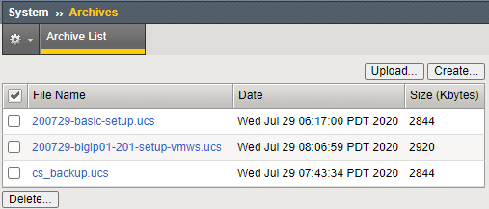
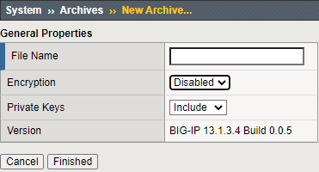

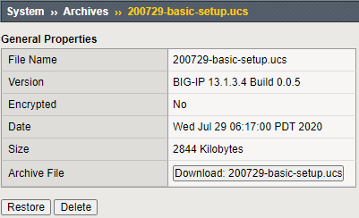

3.05 Execute UCS backup and restore procedure
Manual Chapter : Archives
You can create, delete, restore, upload and download UCS archives from the GUI interface:

Slide 65
3.05 Execute UCS backup and restore procedure
Manual Chapter : Archives
You can also create, delete and restore UCS backups using TMSH, but TMSH has options the GUI doesn’t.
Backup the BIG-IP: save sys ucs <ucs filename>
Restore the BIG-IP: load sys ucs <ucs filename>
If you are restoring an RMA or migrating to a new platform you do NOT want to restore the license.
load sys ucs <filename> no-license
If you are migrating platforms you may not want to restore the base configurations as interfaces may be different.
On the system you are restoring you would build the base first, interfaces, VLANs, self IPs, etc
load sys ucs platform-migrate <filename> no-license
Other TMSH options
no-platform-check Bypass platform check.
passphrase Passphrase for (un)encrypting UCS.
reset-trust Reset device and trust domain certificates and keys whenloading a UCS.

Slide 66
3.05 Explain proper long-term storage of UCS backup file
Store passwords and passphrases securely
After you encrypt configuration object passwords or passphrases on any BIG-IP system, another system can only decrypt them (during a tmsh load config operation) by using the same master key
F5 recommends that you retain a record of each configuration object password or passphrase in a secure location on a system other than the BIG-IP system that uses the password or passphrase.
Doing so makes it possible for you to restore a UCS configuration archive when the original master key is not available.
Store UCS archives securely
Make sure that you regularly back up the BIG-IP system configuration and maintain the backup UCS archives in a secure manner.
The preferred way to store UCS archives securely (encrypts the entire UCS file):
(tmos) # save sys ucs <ucs name> passphrase <passphrase>
These recommendations can be accomplished via the GUI or TMSH interfaces.

Slide 67
3.05 Explain the contents of the UCS file (private keys)
A typical UCS archive contains user accounts, passwords, critical system files, and SSL private keys.
You can explicitly exclude SSL private keys from a UCS archive during the backup process.
From TMSH:
save sys ucs test-backup no-private-key
From the GUI:

Slide 68
Topic Resources
Manual Chapter: Virtual Servers
Manual Chapter : Session Persistence Profiles

Slide 69
2.05
Determine how to secure Self IPs
Compare and contrast traffic groups vs HA groups
Determine what prevented an expected failover
Describe the differences between network failover and hardware failover

Slide 70
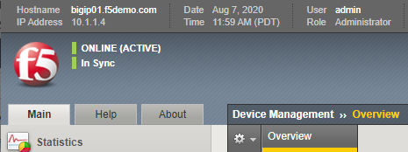
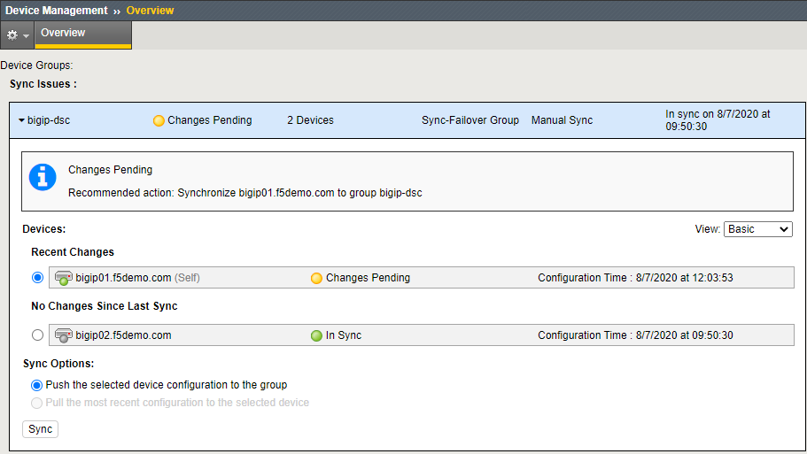
3.10 Show config sync status
Manual Chapter : Managing Configuration Synchronization
By default, synching a configuration is a manual process
[root@bigip01:Active:Changes Pending] config #
Notes:
The config sync status can be seen in a number of different ways;
It is in the upper left hand corner of the big IP GUI next to F5 ball as you can see in the page here In Sync
It can be seen under the device management overview
And as part of the Linux or TMSH prompt
By default config sync is a manual process. The reason for this is to prevent a user from making a misconfiguration and having that erroneous configuration automatically pushed over to the other BIG-IPs in the service cluster so that there is no recovery by just failing over. In that case, recovery would require reconfiguring or restoring from a UCS.

Slide 71
3.10 Explain when a config sync is necessary
K39735803: When to perform a manual ConfigSync
When you make a change to a device in the Device Service Cluster (DSC) and automatic sync is not enabled
Before you begin a software upgrade of a DSC to ensure all configurations are correctly synchronized
After you complete a software upgrade for a BIG-IP device group. after all of the BIG-IP devices in the device group are upgraded to the new BIG-IP software version.
This recommendation applies to device groups configured to use any ConfigSync option, including the Automatic Sync option.
You want to migrate a device group member to a new BIG-IP hardware platform.
Note: For more information, refer to K15496: Migrating a device group member to a new BIG-IP hardware platform..
You want to migrate a BIG-IP configuration to new VIPRION blades.
Note: For more information, refer to K63705154: Migrating a BIG-IP configuration to new VIPRION blades using ConfigSync.
You are using Automatic Sync, and you want to synchronize changes to device group members and immediately save the running configuration to the configuration files on the peer devices.
Notes:
As you can see here there are number of reasons you may need to perform a config sync.

Slide 72
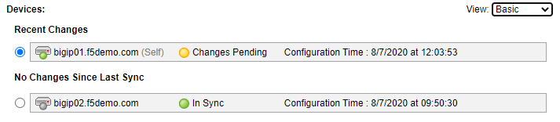

3.10 Compare configuration timestamp
K81160517: Modifying the ConfigSync time threshold
Timestamps can be checks on the status page, switching to Advance will give you more information
Each device checks the remote device's time against its own system time.
If the time is not within the ConfigSync time threshold default value of three seconds, the command prompt changes to indicate that the time is out of sync (Peer Time Out of Sync), and ConfigSync operations may fail.
You may have to increase the threshold to rectify the issue.
This a reason configuring NTP on BIG-IP is so important.
K81160517: Modifying the ConfigSync time threshold shows you how to check and rectify the issue.
Notes:
There is no concept of master or slave into device service cluster. This means that if one admin was on bigip1 and made a change and another admin was on bigip2 and made a change those changes wouldn't sync up. Each device would have a different configuration at that point and a config sync from one device would overwrite the changes on the other device. Comparing configuration timestamps can help an administrator determine which device has the latest configuration or if somehow the devices our out of sync. This is why NTP is vitally important on BIG-IPs in a device service cluster.

Slide 73
3.10 Demonstrate config sync procedure (GUI)
Manual Chapter : Managing Configuration Synchronization
F5 YouTube: Performing a ConfigSync using the Configuration utility ~2 min
You can Push or Pull a configsync
You may want a pull if you make changes you regret
Notes:
So when you need to do a config sync you will have two options, you can push or pull. When you want to perform your config sync procedure you will select the device and then you will either push that device’s configuration to all the other devices in the cluster or you will pull from the other devices in the cluster and overwrite the configuration of the device you selected.

Slide 74
3.10 Demonstrate config sync procedure (TMSH)
K14856: Performing a ConfigSync using tmsh
F5 YouTube: Performing a ConfigSync using tmsh ~1min
run /cm config-sync <sync_direction> <sync_group>
<sync_direction>
force-full-load-push Sync configuration to the specified device group even if
the system would deem this unsafe. This may result in
loss of configuration on other devices.
from-group Sync configuration from specified device group.
recover-sync Resets the local device configuration and restores trust
domain, device, and device-group information to default
settings.
to-group Sync configuration to specified device group.
Notes:
This can also be done from the TMSH command line.

Slide 75
3.10 Report errors which occur during config sync
K13946: Troubleshooting ConfigSync and device service clustering issues
To troubleshoot the ConfigSync operation, perform the following procedures:
Verifying the required elements for ConfigSync/DSC
Reviewing common reasons for ConfigSync failures (recommended viewing)
Viewing the commit ID updates
Verifying a ConfigSync operation
Verifying the Sync status
Understanding Sync status messages (recommended viewing)
Reviewing the log files for ConfigSync error messages (recommended viewing)
Notes:
There are number of things that can cause errors in the config sync process or in the device group .
For one thing devices in in a cluster must have the same licensing and same provisioning.
They must be running on the same software version.
NTP again is important they should all have the same time.
The config sync IP has to be configured on each device, the failover IP has to be configured on each device and the correct ports have to be open on these IPs for the process to work correctly.
Also a device trust must have been established and functioning so that we have secure communications between the devices .
These are just some of the reasons you may have issues performing synchronization. As you can see there are a number of links that I have provide you to learn more about this topic.

Slide 76
3.02
Apply procedural concepts required to manage the state of a high availability pair
Report current active/standby failover state
Show device trust status
Execute force to standby procedure
Execute force to offline procedure

Slide 77
Before we begin: A little more on Device Service Clusters.
Manual : BIG-IP Device Service Clustering: Administration
For BIG-IPs to be combined into clusters for high availability, certain things must configured:
BIG-IPs must have a valid device certificate
On the device, IP addressing must be defined for failover
Devices must be place into a trust group
Devices in a trust group and then be place into a failover group
Notes:
The blueprint is a little vague on how much you need to know about device service clusters, so before we go any further let’s do a brief overview.
For BIG-IPs to be combined into sync-failover groups, that is be able to synchronize configuration and failover to each other and a basic understand of this process will help you troubleshoot HA issues. The following needs to happen:
The BIG-IP must have a valid device certificate and IP address for configuration sync, network failover (if desired) and mirroring (if desired) must be configured.
The BIG-IPs must then be place into a device-trust-group. Here they will share device certificates for secure communication and the aforementioned IP addressing
The devices in a device-trust-group can then be place into a device-group, which is define as a sync-failover group or sync-only
Traffic groups can then be configured, by default base IP address goes into traffic-group-local-only and all other listeners go into traffic-group-1

Slide 78
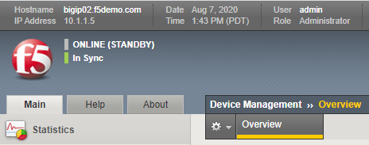
3.02 Report current active/standby failover state
Manual : BIG-IP Device Service Clustering: Administration
[root@bigip01:Active:In Sync] config #
[root@bigip02:Standby:In Sync] config #
Active – there are one of more active traffic groups that can failover
Standby – there are no active traffic groups that can failover
Notes:
Like config sync, the failover state can be found in the GUI and at the command prompt. A device in an active failover state simply means that there is an active traffic group on the BIG-IP processing traffic . A big IP in a standby failover state means that there simply are no active traffic groups on the BIG-IP. Although the blueprint doesn’t specifically talk about traffic group, a brief explanation is probably in order.
Traffic groups are a combination of listeners; virtual addresses, SNATs, floating self IPs etc, that are required to process the traffic for one or more applications. By default there are two traffic groups on a BIG-IP, traffic-group-local-only (non-floating) and traffic-group-1 (floating). traffic-group-local-only contains listeners that are unique to the BIG-IP (ie. Base self IPs) and go down when the BIG-IP does. traffic-group-1 and all other subsequent traffic groups created contain listeners that can and need to failover to other BIG-IPs.
On a pair of BIG-IPs, using the default configuration, having only one traffic groups with all the applications in it, one BIG-IP will always be active and the other in standby mode. If you were to configure a second traffic group and run one traffic group on each BIG-IP they would be in an active-active mode.

Slide 79
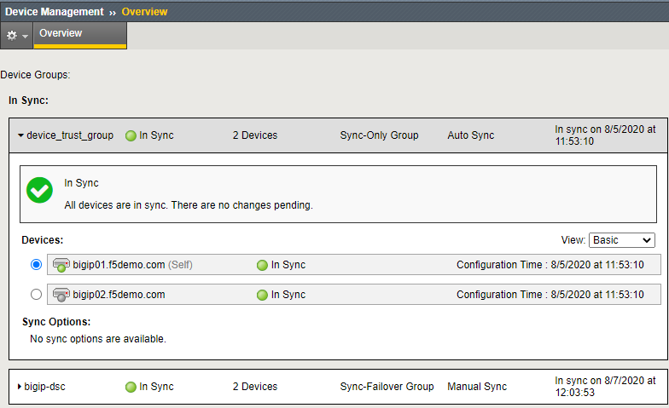
3.02 Show device trust status
Manual Chapter : Managing Device Trust
(tmos)# show cm device-group device_trust_group
-----------------------------------------------------------
CM::Device-Group
-----------------------------------------------------------
Group Name device_trust_group
Member Name bigip01.f5demo.com
Time Since Last Sync (HH:MM:SS) 50:27:21
Last Sync Type full-load-auto-sync
CID Originator /Common/bigip02.f5demo.com
CID Time (UTC) 2020-Aug-05 18:53:10
LSS Originator /Common/bigip02.f5demo.com
LSS Time (UTC) 2020-Aug-05 18:53:10
-----------------------------------------------------------
CM::Device-Group
-----------------------------------------------------------
Group Name device_trust_group
Member Name bigip02.f5demo.com
Time Since Last Sync (HH:MM:SS) -
Last Sync Type none
CID Originator /Common/bigip02.f5demo.com
CID Time (UTC) 2020-Aug-05 18:53:10
LSS Originator /Common/bigip02.f5demo.com
LSS Time (UTC) 2020-Aug-05 18:53:10
Notes:
BIG-IPs must be part the same device trust group to be allowed to be combined into device groups,. Should the device trust be broken, no synchronization or failover can take place. An example problem might be the device certificate expiring. You should always confirm the device trust status in In Sync.

Slide 80
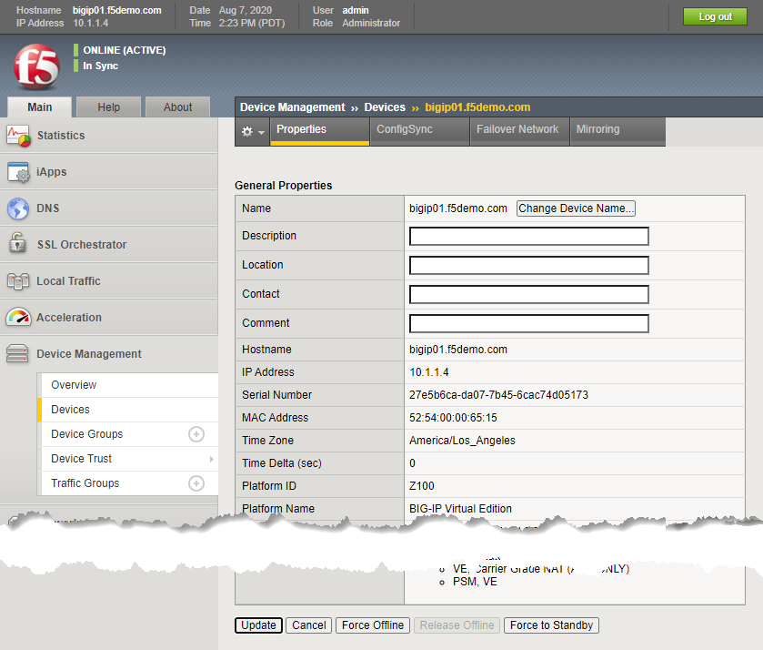
3.02 Execute force to standby or offline procedure
Manual : BIG-IP Device Service Clustering: Administration
(tmos)# run sys failover
offline Changes the status of a unit or cluster to Forced Offline. If persist or no-persist are not specified, the change in status will be persisted in-between system restarts.
online Changes the status of a unit or cluster from Forced Offline to either Active or Standby, depending upon the status of the other unit or cluster in a redundant pair.
standby Specifies that the active unit or cluster fails over to a Standby state, causing the standby unit or cluster to become Active.
Notes:
Important. You cannot force BIG-IP to become an Active BIG-IP, you can only force it to Standby or Offline. At the device level, this will force all traffic groups to failover to other members of the cluster. Under the Traffic Groups selection on the side-bar you can force individual traffic groups to failover to other devices in the clusters.

Slide 81
Other HA concepts not explicitly called out in the blueprint
Manual : BIG-IP Device Service Clustering: Administration
Device Service Clusters (DSCs) can consist of more than two BIG-IPs supporting each other
Know where to find where failover objects on BIG-IP in the DSC will fail to
Understand the difference between Active-Standby and Active-Active
You probably should have a working knowledge of Device Trust and the Device Trust Group
Have a working knowledge of mirroring.
SNAT
Persistence
Only if persistence records are kept locally on the BIG-IP, not necessary for Cookie persistence.
Connection Table
Only for long term connections, ie. FTP, resource intensive
Notes:
On the chance that you need more information on high availability for the exam, let’s cover a few more items at a high level.
Note that more that up to 8 BIG-IPs can be part of a sync-failover group
You can find where a traffic-group will fail on the Traffic Groups page
For seamless failover certain information may need to be mirrored to the next active device (the BIG-IP a traffic group will fail to):
SNAT mirroring makes sure the failover device knows which SNAT IP:port combination a client was using to communicate to the pool member
Persistence mirroring, send persistence records created and maintain be the BIG-IP to the failover device
Connection mirroring, done on a per virtual server basis, mirrors the connection table entries for that virtual server.

Slide 82
Other HA concepts not explicitly called out in the blueprint
Manual : BIG-IP Device Service Clustering: Administration
Devices (Self)
On the (Self) Device, which is the device you are on there are several configuration items you show know
These must be configured prior to building the device trust group
ConfigSync - IP address the BIG-IP listens for synchronizing configuration changes (TCP port 4353)
Failover Network - IP address the BIG-IP uses to send and receive polls to determine the state of other BIG-IPs in the cluster (TCP port 1026)
Mirroring - IP address where mirrored information is sent and received
Notes:
Other reasons high availability may not be working is because the correct ports are not open on the failover IPs for the required communications.
Here are the IP addresses and primary ports required for high availability. Not all the ports required are listed here.

Slide 83
Topic Resources
Manual Chapter: Virtual Servers
Manual Chapter : Session Persistence Profiles

Slide 84
2.06
Apply concepts required to use BIG-IP functionality to fulfill security requirements
Make use of port lockdown
Demonstrate how to restrict access to management interface
Demonstrate how to restrict access to virtual servers

Slide 85
3.03 Interpret port lockdown settings to Self-IP
Port Lockdown determines which ports a self IP address will respond too
By default Port Lockdown is none, the self IP only responds to ICMP
Port Lockdown settings can be modified to allow other traffic, such as, port 443 or 22 for management

Slide 86
3.03 Interpret port lockdown settings to Self-IP
You can select “Allow Default” which opens the following:
ospf:any
tcp:domain (53)
tcp:f5-iquery (4353)
tcp:https (443)
tcp:snmp (161)
tcp:ssh (22)
udp:520
udp:cap (1026 - for network failover)
udp:domain (53)
udp:f5-iquery (4353)
udp:snmp (161)
Or you can select custom ports to open
list net self
net self client_ip {
address 10.1.10.245/24
allow-service {
tcp:ssh
tcp:https
}

Slide 87
3.03 Identify SSH access list to management-IP address
K13309: Restricting access to the Configuration utility by source IP address (11.x - 16.x)
To add to the allow list:
modify /sys sshd allow add { <IP address or IP address range> }
Range uses space ie. {10.1.1.1 10.1.1.10}
To replace the list
modify /sys sshd replace-all-with {<IP address or IP address range>}
Default is:
Save the change by entering the following command:
save /sys config
(tmos)# list sys sshd allow
sys sshd {
allow { All }
}
Notes:
You can restrict access to the management port, both SSH and GUI via access list.

Slide 88
3.03 Identify HTTP access list to management-IP address
K13309: Restricting access to the Configuration utility by source IP address (11.x - 16.x)
To add to the allow list:
modify /sys httpd allow add { <IP address or IP address range> }
To replace the list
modify /sys httpd replace-all-with {<IP address or IP address range>}
Default is:
Save the change by entering the following command:
save /sys config
(tmos)# list sys httpd allow
sys httpd {
allow { All }
}

Slide 89
Restricting Access to Management Ports on Self IPs
(src host 192.168.13.139 or src net 11.1.1.0/24)

Slide 90
Packet Filtering
Disabled be default, but once you enable
Notes:
<intentionally left blank>

Slide 91
Topic Resources
Manual Chapter: Virtual Servers
Manual Chapter : Session Persistence Profiles

Slide 92
2.07
Determine how configuration changes affect existing and new connections
Predict persistence for existing connections
Calculate when changes will affect the connections
Predict load balancing and persistence for new connections
Determine the impact of virtual server configuration change on traffic

Slide 93
Topic Resources
Manual Chapter: Virtual Servers
Manual Chapter : Session Persistence Profiles

Slide 94
2.08
Explain the uses of user roles, administrative partitions, and route domains
Explain how to restrict access to LTM using user roles
Discuss the benefits of administrative partitions
Apply user roles to administrative partitions
Explain the functionality of route domains
Summarize how the 3 technologies can be used together

Slide 95
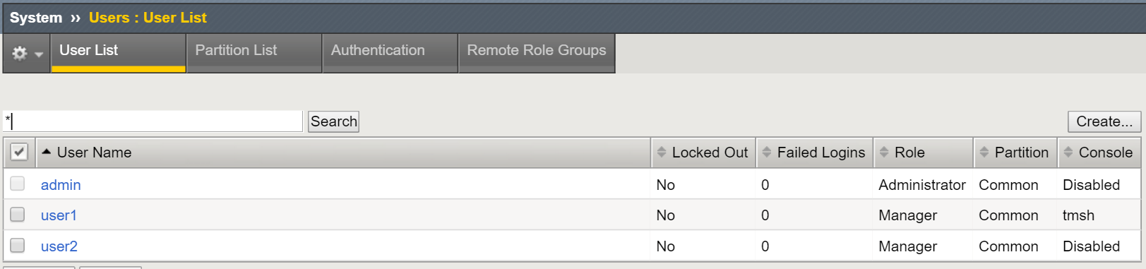
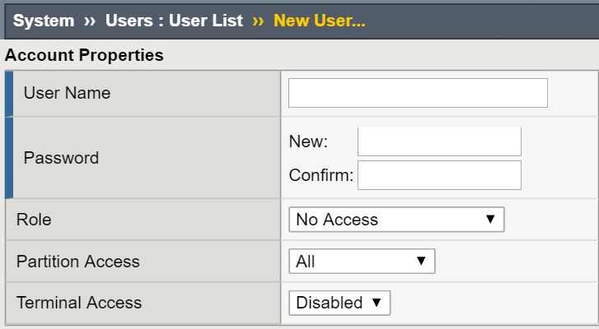
3.08 Explain how to create a user
Manual : BIG-IP Systems: User Account Administration
User and Password are required
Assign a role
Assign partition access
A user may be assigned to one partition or All partitions
Assign the type of terminal access (Specify the type of CLI access)
Disabled
The user may access only the GUI interface
TMSH
Permits the user access to the TMOS CLI shell via SSH
Advanced Shell
Permits user access to the Linux prompt
Administrator and Resource Administrator only
Notes:
<intentionally left blank>

Slide 96
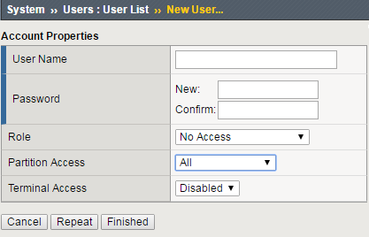
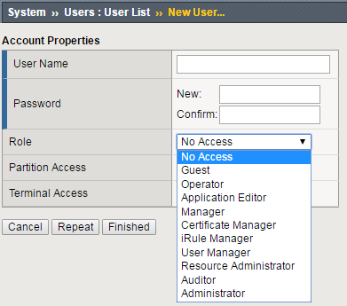
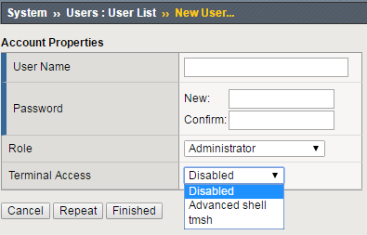
Explain how to create a user
Manual : BIG-IP Systems: User Account Administration

Slide 97
User Roles (most common)
Manual : BIG-IP Systems: User Account Administration
No Access
Prevents users from accessing the system.
Guest
Grants users limited, view-only access to a specific set of objects.
Operator
Grants users permission to enable or disable existing nodes and pool members.
Application Editor
Grants users permission to modify existing nodes, pools, pool members, and monitors.
Manager
Permission to create, modify, and delete virtual servers, pools, pool members, nodes, custom profiles, custom monitors, and iRules.
Administrator
Grants users complete access to all objects on the system.

Slide 98
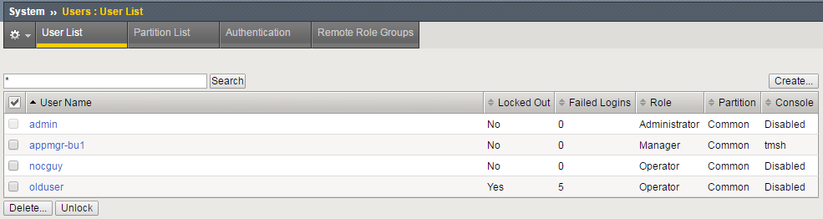
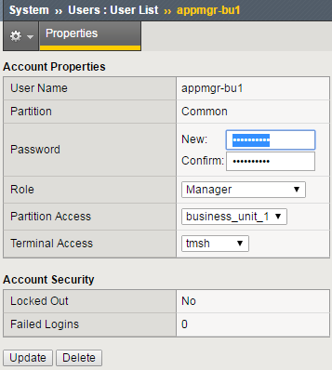
3.08 Explain how to modify user properties
Just go back in and change them

Slide 99
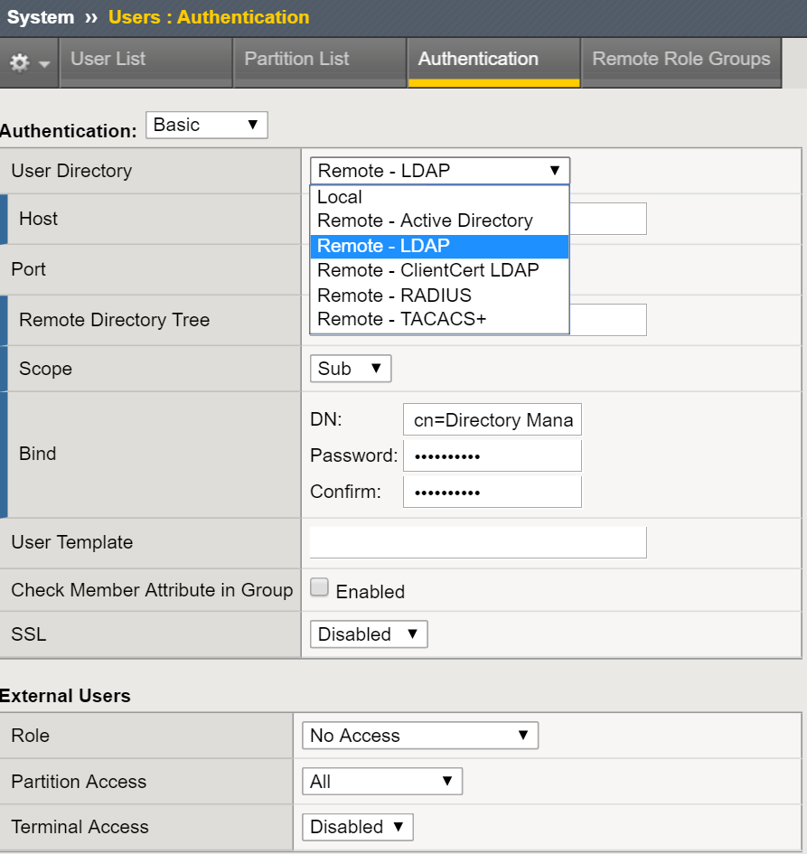
3.08 Explain options for remote authentication provider
Manual : BIG-IP Systems: User Account Administration
Still will always need a least one admin local account
For config sync functionality
In case you lose access to authentication server
Supports AD, LDAP, TACACS+ and RADIUS

Slide 100
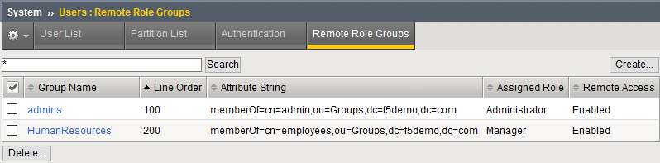
3.08 Explain use of groups using remote authentication provider
Manual : BIG-IP Systems: User Account Administration
For a remote group you can chose to:
Enable/disable remote access
Assign a permissions role to members of the group
Select All/Common/Specific name partition access
Select the type of terminal access required.

Slide 101
Topic Resources
Manual Chapter: Virtual Servers
Manual Chapter : Session Persistence Profiles

Slide 102
2.09
Determine how to deploy or upgrade vCMP guests and how the resources are distributed
Explain the different vCMP guest deployment states
Discuss the relationship between CPU and memory on vCMP
Select which versions can run on a guest given host version
Understand the relationship of network configuration objects between vCMP hosts and vCMP guests

Slide 103
Topic Resources
Manual Chapter: Virtual Servers
Manual Chapter : Session Persistence Profiles

Slide 104
BREAKTIME

Slide 105
F5 Learning: Getting Started with BIG-IP
This course is divided into two modules:
The Administration module focuses on basic administrative activities on the BIG-IP system. You’ll learn how to activate a new BIG-IP system for operation, including configuring the management port, licensing, provisioning, and basic network configuration. You’ll learn how to archive the BIG-IP configuration in support of data center backup and recovery activities. Finally, you’ll learn how to verify the proper operation of your BIG-IP system by using the online BIG-IP iHealth® diagnostic tool.
Launch: Getting Started with BIG-IP Part 1: Administration
Demo: Setup Utility
The Application Delivery module focuses on the basic building blocks of BIG-IP configuration in support of application delivery including nodes, pools and pool members, virtual servers, monitors, and profiles. You’ll learn how to configure a basic web application that is delivered through the BIG-IP system, and includes round robin load balancing, HTTP application health monitoring, overcoming routing issues with SNATs, and SSL offload (client SSL termination). You’ll also learn how to review the flow of application traffic through the BIG-IP system using local traffic statistics.
Launch: Getting Started with BIG-IP Part 2: Application Delivery
Demo: Application Delivery
To access Getting Started Virtual Labs, please login or create an account in the new LearnF5, then search for "Getting Started with BIG-IP".

Slide 106
F5 Free Training: Getting Started with BIG-IP Local Traffic Manager (LTM)
This course is divided into four modules that are presented in two separate WBTs. The topics presented are organized around a customer scenario that takes an organization’s globally expanding e-commerce site from a single server to multiple load balanced back end servers behind a pair of BIG-IP LTM systems. You’ll learn how to implement the high availability feature to establish an active/standby device service cluster. You’ll learn how to load balance web application traffic across a pool of non-homogenous servers. You’ll learn how to use an iRule to customize traffic flow, selecting the appropriate pool of back end servers based on the client’s preferred content language. And finally, you’ll learn how to decrease existing server load reducing concurrent connections and connection rates using OneConnect.
Launch: Getting Started with LTM Part 1: HA and Traffic Processing
Demo: Configure High Availability
Launch: Getting Started with LTM Part 2: iRules and OneConnect
Demo: iRules

Slide 107
F5 Free Training: Getting Started with BIG-IP iHealth
This course is intended to help you get started using BIG-IP iHealth as an online diagnostic tool. You’ll learn how to leverage this tool to proactively maintain and more quickly troubleshoot your BIG-IP systems. The course describes how BIG-IP iHealth Diagnostics evolved from an internal tool into a free, online tool available to F5 customers. It explains the four-step process to generate iHealth Diagnostics and introduces iHealth reports. The remainder of the course describes how to use iHealth to identify security vulnerabilities and performance issues, prepare to upgrade your system, and leverage iHealth to troubleshoot system configuration issues and ensure your hardware platform is running at peak performance. The course is based on user-centered simulations and will take 15 minutes to complete.
Launch: Getting Started with BIG-IP iHealth

Slide 109
USE CASE: “Deliver any application on-premises or in the cloud with BIGIP"
Improve website performance and availability: With BIG-IP Local Traffic Manager, you can ensure your website is always available and performing at its best. By intelligently distributing traffic and managing connections, BIG-IP LTM can optimize website delivery, improve response times, and prevent downtime, even during peak traffic periods.
Securely manage and control application traffic: BIG-IP provides advanced security features that enable you to safely manage and control application traffic. With SSL/TLS offloading, advanced access control, and granular application-level policies, you can protect your applications and sensitive data from malicious attacks and unauthorized access.
Simplify application deployment and management: BIG-IP simplifies application deployment and management with powerful automation and orchestration capabilities. With easy-to-use interfaces and tools, you can quickly provision and manage applications, and automate routine tasks to save time and reduce errors. Comprehensive monitoring and analytics, gain valuable insights into application performance and make informed decisions to optimize your infrastructure.
Secure APIs and microservices: BIG-IP Local Traffic Manager provides robust API security features that help you protect your APIs and microservices from threats. With support for modern authentication and authorization protocols like OAuth and OpenID Connect, BIG-IP LTM can authenticate and authorize API requests, prevent unauthorized access, and protect sensitive data. Additionally, with advanced traffic management capabilities like rate limiting and content-based routing, you can ensure API availability and performance.
Notes:
Improve website performance and availability: With BIG-IP Local Traffic Manager, you can ensure your website is always available and performing at its best. By intelligently distributing traffic and managing connections, BIG-IP LTM can optimize website delivery, improve response times, and prevent downtime, even during peak traffic periods.
Securely manage and control application traffic: BIG-IP LTM provides advanced security features that enable you to safely manage and control application traffic. With SSL/TLS offloading, advanced access control, and granular application-level policies, you can protect your applications and sensitive data from malicious attacks and unauthorized access.
Simplify application deployment and management: BIG-IP LTM simplifies application deployment and management with powerful automation and orchestration capabilities. With easy-to-use interfaces and tools, you can quickly provision and manage applications, and automate routine tasks to save time and reduce errors. Plus, with comprehensive monitoring and analytics, you can gain valuable insights into application performance and make informed decisions to optimize your infrastructure.
Secure APIs and microservices: BIG-IP Local Traffic Manager provides robust API security features that help you protect your APIs and microservices from threats. With support for modern authentication and authorization protocols like OAuth and OpenID Connect, BIG-IP LTM can authenticate and authorize API requests, prevent unauthorized access, and protect sensitive data. Additionally, with advanced traffic management capabilities like rate limiting and content-based routing, you can ensure API availability and performance.

